Slide 1
Lesson 5
Daily Wellbeing Check-in
Key Skills
Being Literate, Managing Myself, Staying Well, Managing Information & Thinking, Being Numerate, Working With Others, Communicating
Statements of Learning
1, 3, 10, 11, 12, 13

Slide 2
Responsible | Active | Respected
Connected | Resilient | Aware
Examine and assess my own wellbeing in a given moment.
Analyse different elements which contribute to positive wellbeing
Plan actions that I can take to improve my own wellbeing.

Slide 3
A Mindful Moment
Notes:
YOUTUBE - Mindful Minute; Raindrops
https://www.youtube.com/watch?v=6z9Vmp9Jqm0
Use this quick Mindful Minute exercise to refocus your attention to the present moment.

Slide 4
Daily Wellbeing Check-in
When you are busy with school work, study, sports commitments, socialising with friends and lots of other things going on in your life, you may become exhausted, stressed out or even experience burn out.
That is why it is important to take time out and check if you are doing everything possible to safeguard your wellbeing.
Today you will take stock of how you are and create an action plan on how to further nurture your wellbeing.

Slide 5
Water
Water makes up roughly 60% of your body weight and is essential to good health.
It's needed to regulate body temperature, transport oxygen and nutrients to cells, flush toxins from organs,
keep your skin moist and cushion your joints.
Being properly hydrated helps your body to function at its best.
Survey Question:
Do you know how much water a teenager should drink per day?

Slide 6
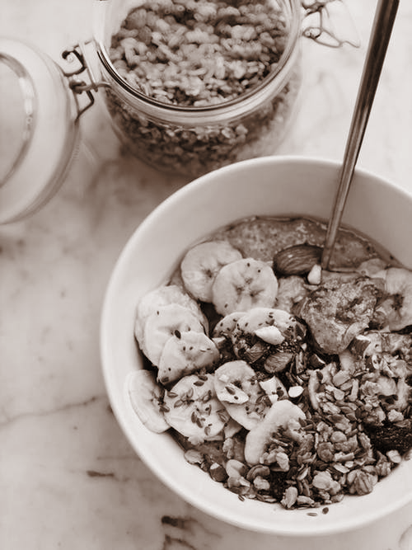
Balanced Diet
Eating a healthy, balanced diet is an important part of maintaining good health, and can help you feel your best. This means eating a wide variety of foods in the right proportions. Consuming the right amount of food helps to achieve and maintain a healthy body weight.
Teens need extra nutrients to support bone growth, hormonal changes and organ and tissue development, including the brain.
Survey Question:
Can you describe and explain how the food pyramid is used?

Slide 7
Sleep
Sleep is food for the brain. During sleep, important body functions and brain activity occur.
Teens need more sleep because their bodies and minds are growing quickly.
Teens who are deprived of sleep may feel moody, look exhausted and also be unable to focus or concentrate and therefore perform poorly in class and in exams.
Survey Question:
Do you know how much sleep a teenager needs per night?

Slide 8
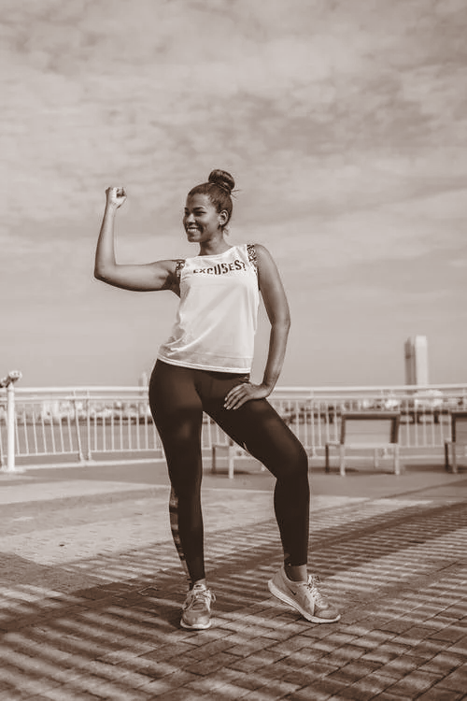
Exercise
Regular exercise for teenagers ensures a healthy weight, strong muscles and bones, improved heart health and a good posture.
Exercise is important for the teenage body because it not only promotes physical health, but also significantly improves mental health by building self-confidence and helping with body image.
Survey Question:
Do you know how much exercise a teenager should do per week?

Slide 9
Balance
A lot of teenagers feel societal pressure and have a lot on their plate and so it is important to find a way to balance everything - from school work and study, to sports commitments, socialising with friends, etc.
Making time for yourself in a busy day by switching off from social media or getting outside for some fresh air can make the world of difference and help you to refocus and improve your wellbeing.
Survey Question:
Do you know of beneficial ways to create balance in a busy life?

Slide 10
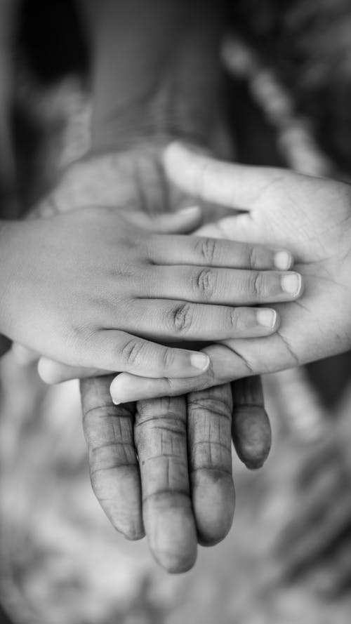
Family and Friends
Building and maintaining strong relationships with family and friends is very important to your wellbeing. These are the people who will be with you throughout your life, encouraging you and supporting you through the good times and the difficult challenges.
By nurturing relationships which are positive and respectful you will have a deeper capacity for caring, empathy and communication for others.
Survey question:
Can you identify characteristics of a good relationship?

Slide 11
Complete the Journal Activity (A) on page 25 in your Student Journal.

Slide 13
Complete the Journal Activity (B) on page 26 in your Student Journal.

Slide 14
Examine and assess my own wellbeing in a given moment.
Analyse different elements which contribute to positive wellbeing
Plan actions that I can take to improve my own wellbeing.

